Slide 1


Process-Structure Linkages for Grain Boundary Pinning During Grain Growth
CSE 8803/ME 8883 Fall 2015
Frederick Hohman, David Montes de Oca Zapiain, Evdokia Popova

Slide 2
Outline
Background and Motivation
Model Development (Data Driven)
Results
Conclusions

Slide 3

Background
The driving force for grain growth is the grain boundary interfacial free energy.
Common practice in manufacturing to add “pins” to control the final grain size.
Notes:
Adding insoluble particles “pins”, deters, the growth of a grain by reducing the surface area when a grain boundary crosses path with a precipitate.

Slide 4
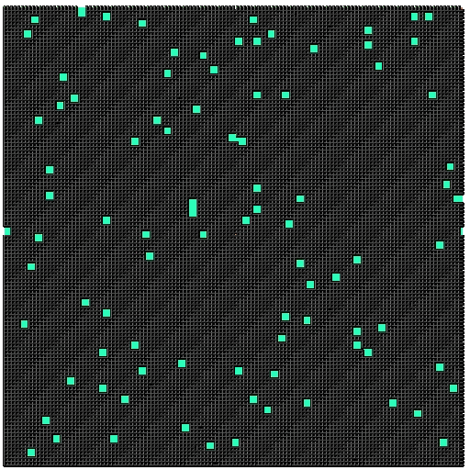

SPPARKS Grain Growth Simulations
SPPARKS: a widely used open source tool to model pinned grain growth.
SPPARKS uses Kinetic Monte Carlo equations to simulate the grain growth.
Notes:
After performing this simulation the grain size of the resulting microstructure can be obtained.
Many tools are available that simulate the “pinned” grain growth phenomenon.

Slide 5
Objective
Use Data Science Approach to extract Process-Structure Linkages for grain boundary pinning simulations during grain growth.
Identify the correlations that exist between an initial distribution of precipitates and the grain size of a final microstructure.
Build a surrogate model for SPPARKS grain growth simulations.
Notes:
Use Data Science Approach to identify the correlations that exist between an initial distribution of precipitates and the final grain size of a microstructure after simulating grain growth.

Slide 6
Data Science Approach
Four major steps for a material informatics problem.
Defining local states: 3-phase material (grains, boundaries, and pins)
2-point statistics: autocorrelation of pins
PCA I/O, visualize with 3 components
Model development: linear regression

Slide 7
Workflow / Data Pipeline
Given Parameters
Input
SPPARKS
Output
MS Function
Raw Data
Chord Length Dist.
Segmentation
Chord Length Computation
2-pt. Statistics
Autocorrelations
PCA
PCA
PC Values
Analysis
PC Values
Regression
Model

Slide 8
Data Generation
Simulation Parameters
300x300x300 voxel microstructure
Periodic boundary condition
Randomized initial microstructure
20K Monte-Carlo time steps
Constant temperature
Data generated
5 different classes of precipitate distribution
Total: 220 different grain growth simulations
Notes:
20K was chosen arbitrarily but it was chosen thinking that it would be sufficient steps to ensure that the MS is not changing that much.
Same initial MS for all simulations.

Slide 9
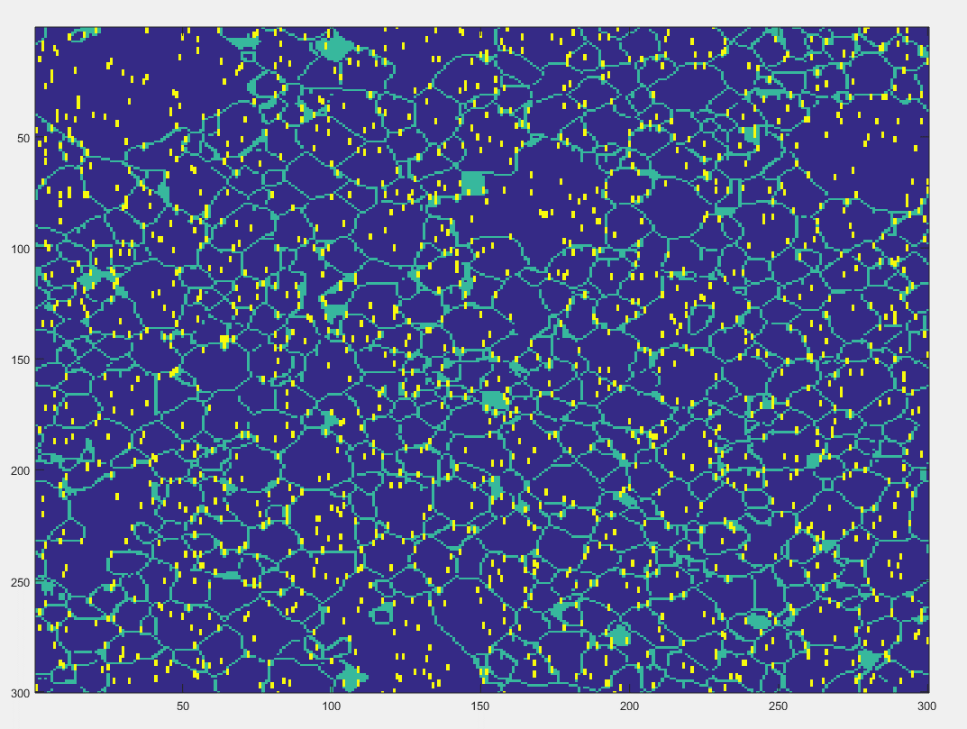
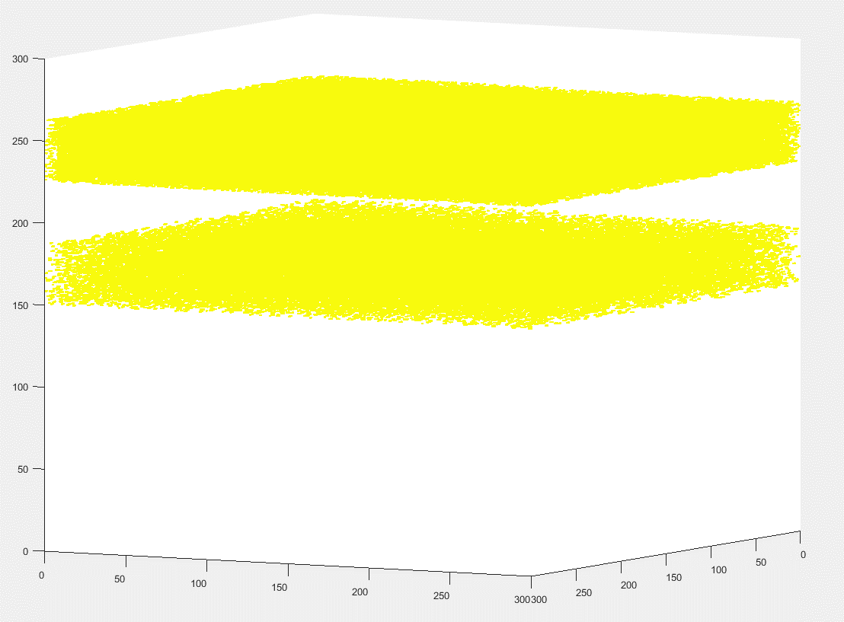
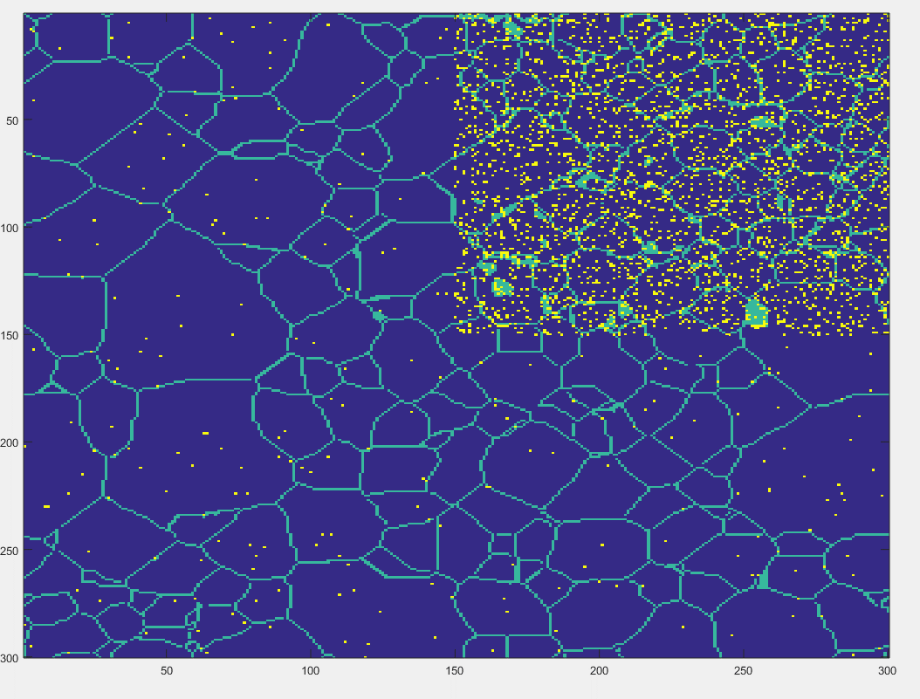
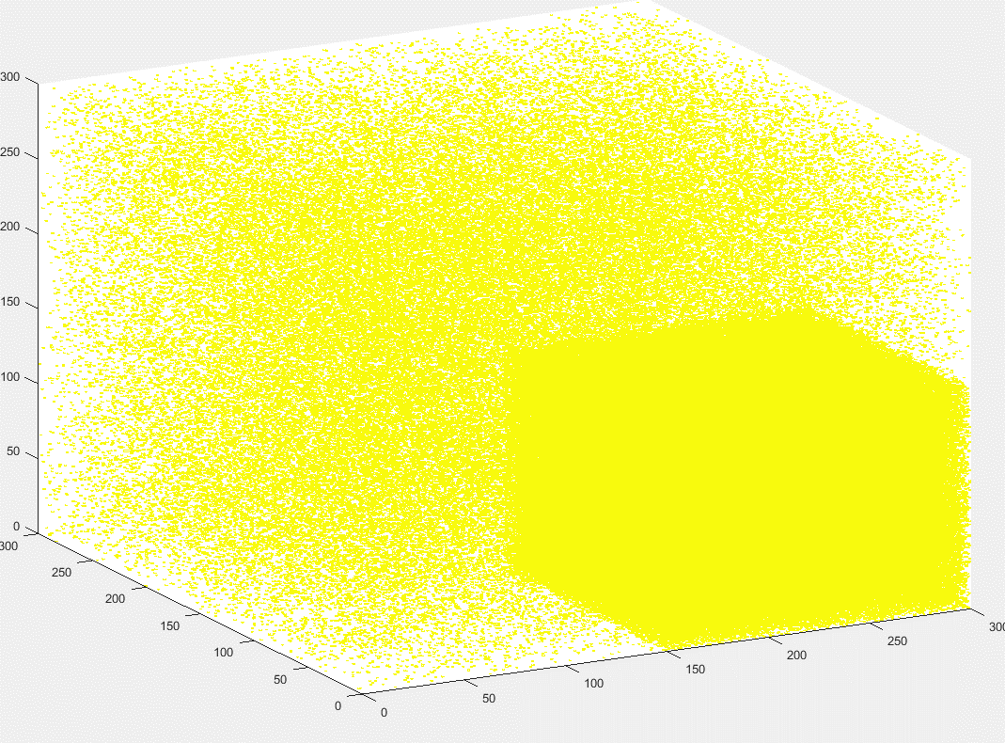
Precipitate Distribution Classes
Band Cluster
Quadrant Cluster

Slide 10
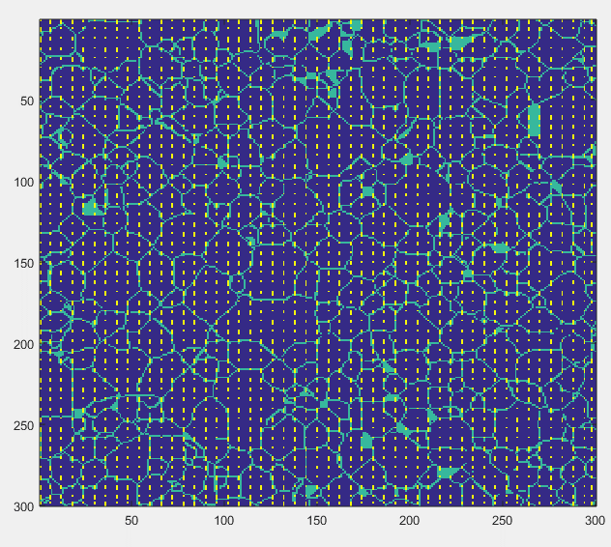
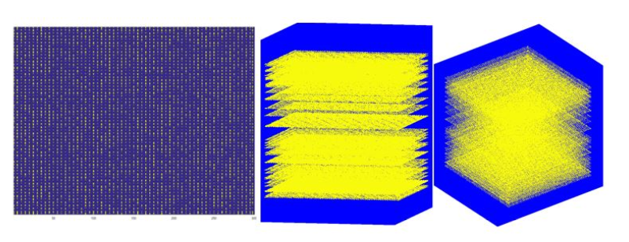
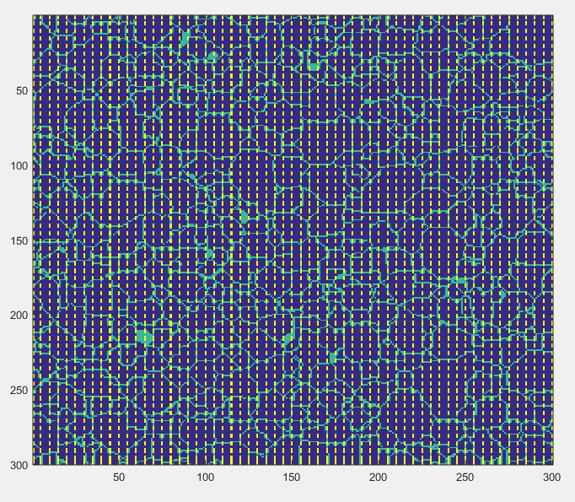
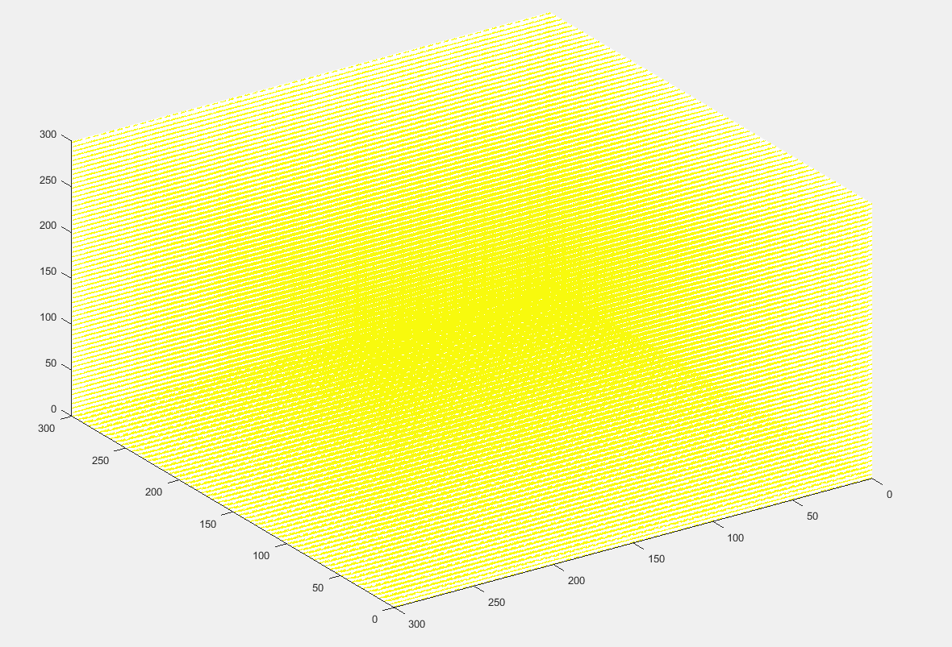
Precipitate Distribution Classes
Rolling
Uniform

Slide 11
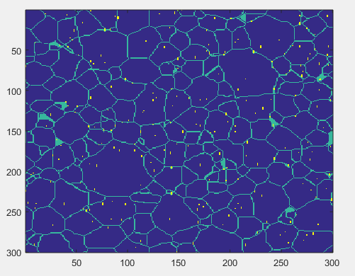
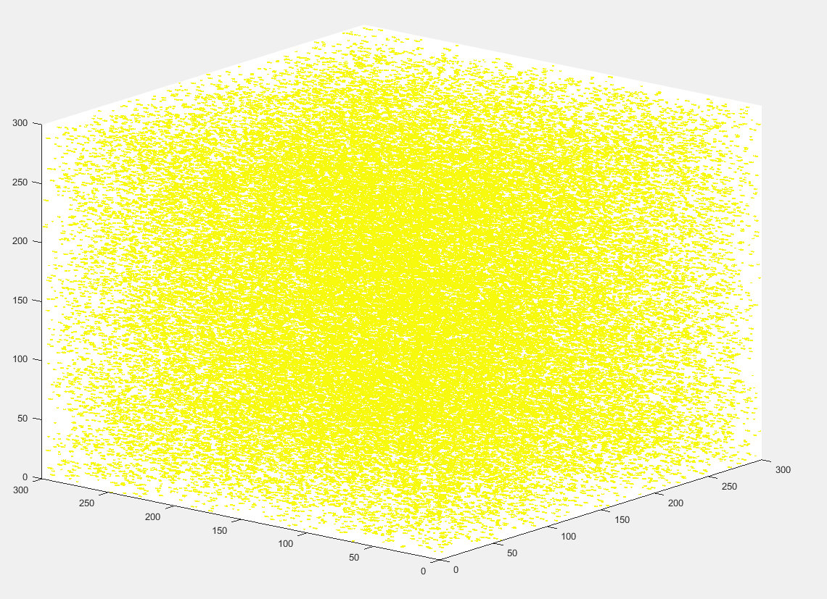
Precipitate Distribution Classes
Random

Slide 12
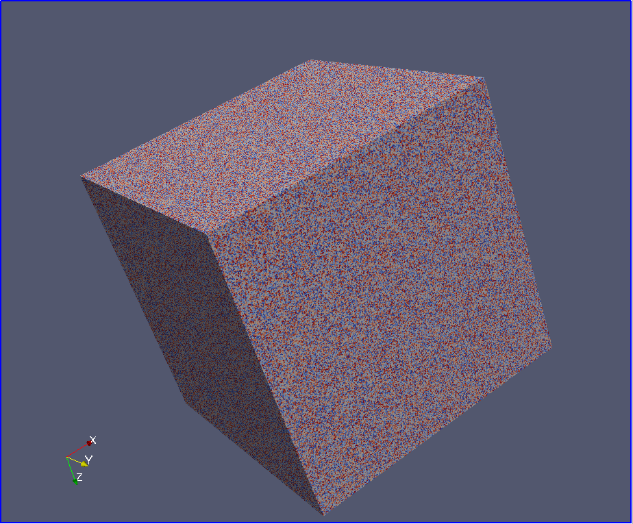
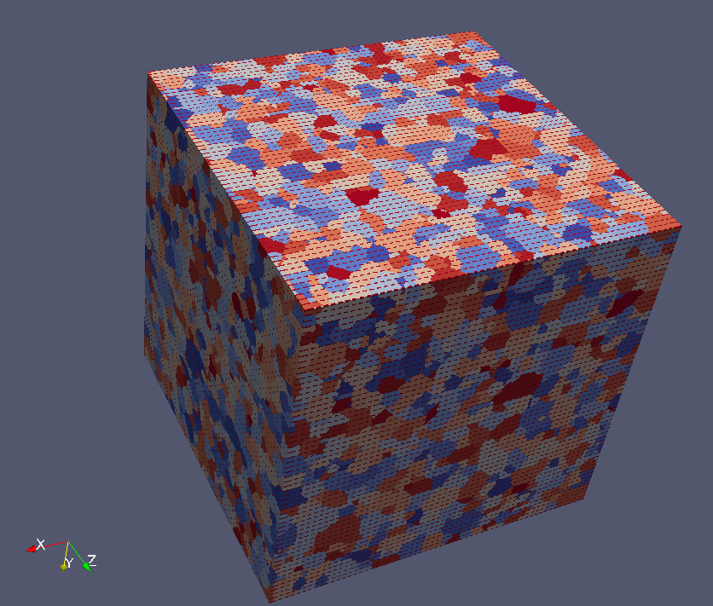
Input and Output of a Simulation
SPPARKS
Input
Shape of precipitate (1, 2, and 3 voxel long precipitates)
[.5%-3%] Volume Fraction of Precipitates
Distribution of the precipitates
Output
From which grain size distribution will be extracted
Define a correlation between process parameters and grain size distribution of a final microstructure to build a surrogate model.
Notes:
Also another advantage of 2pt stats is that it gives the 3d vector between pins and pins.
Thus the input for the model should capture these factors.
The most useful way to capture all of the above mentioned parameters is with 2 point statistics. Specifically with an autocorrelation of precipitates to precipitates.
The grain size distribution of the MS at the end of the simulation needs to be extracted.

Slide 13
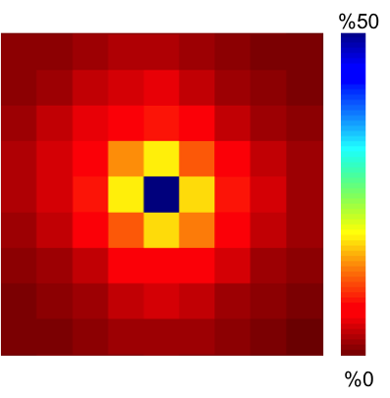
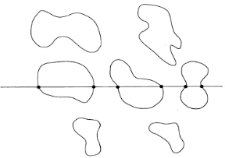
Input and Output of the Surrogate Model
Surrogate
Model
Input
2pt statistics (autocorrelation of pins)
Output
Chord length distribution in the 3 orthogonal directions
Notes:
Also another advantage of 2pt stats is that it gives the 3d vector between pins and pins.
Thus the input for the model should capture these factors.
The most useful way to capture all of the above mentioned parameters is with 2 point statistics. Specifically with an autocorrelation of precipitates to precipitates.
The grain size distribution of the MS at the end of the simulation needs to be extracted.

Slide 14
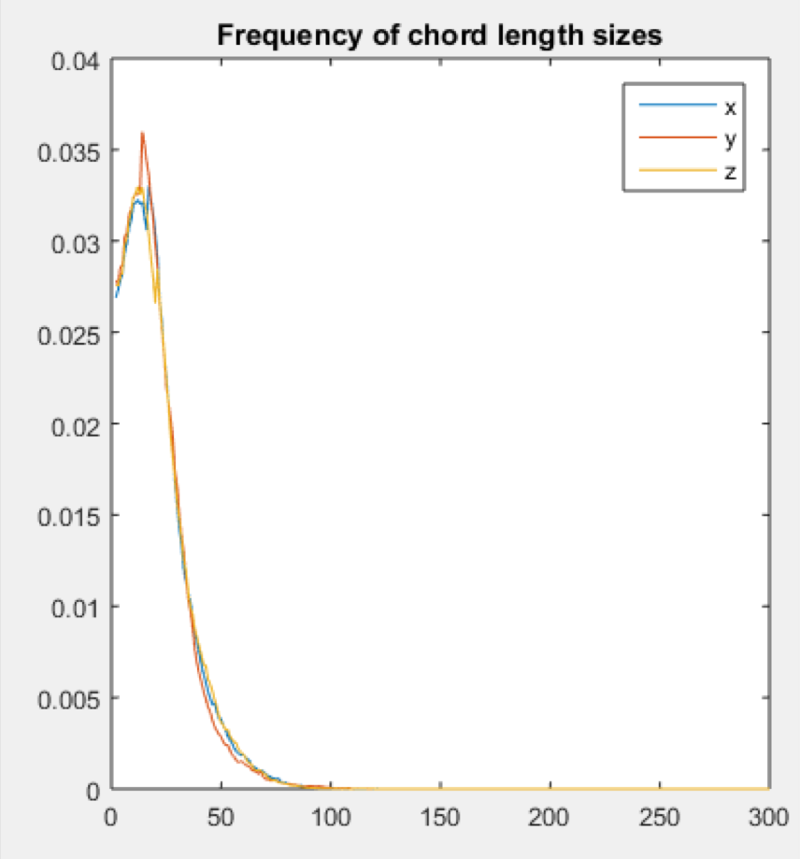
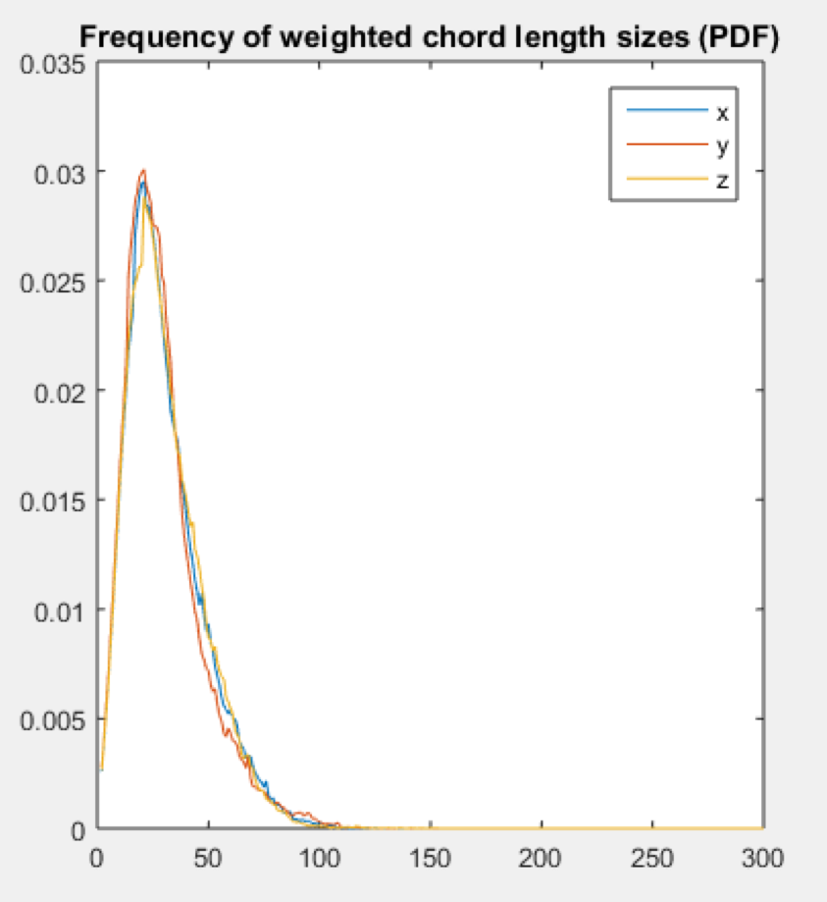
Details on Chord Length Distribution
Obtain a histogram of the different chord lengths in the three orthogonal directions.
Assign a heavier “weight” to the bigger chords by multiplying frequency by its size and dividing by the cumulative sum.
Notes:
Also another advantage of 2pt stats is that it gives the 3d vector between pins and pins.
Divide it by the number of chords to obtain frequency of chord length sizes.

Slide 15
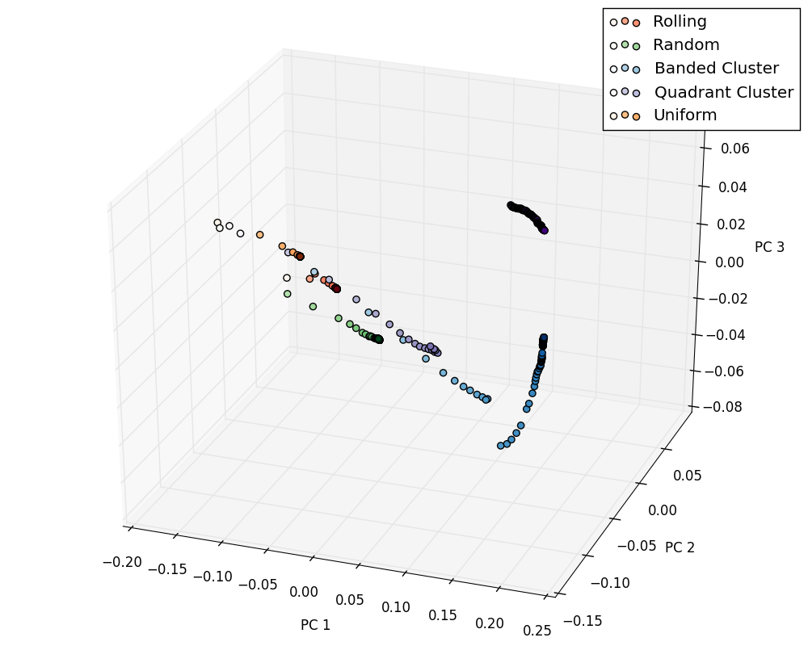
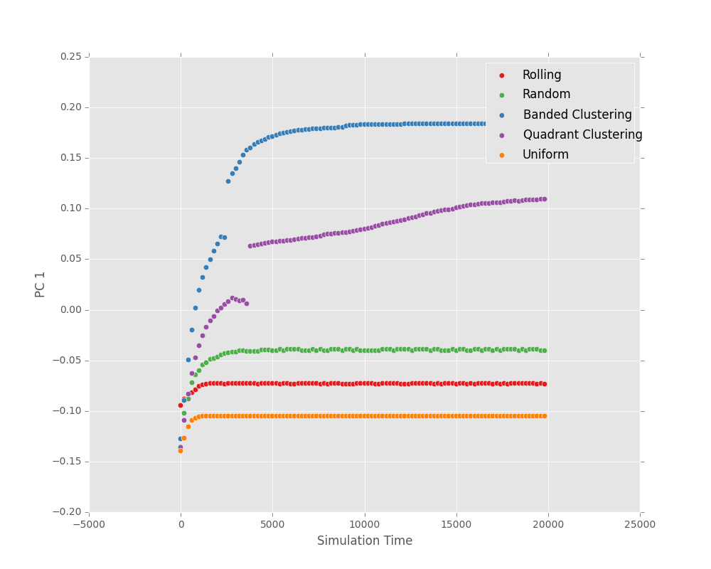
Confirming “Steady State”
Verify SPPARKS simulation ran long enough to reach steady state.
Notes:
Since steady state does not occur in Kinetic Montecarlo, what it is meant that our data is not changing and has reached some sort of equilibrium.

Slide 16
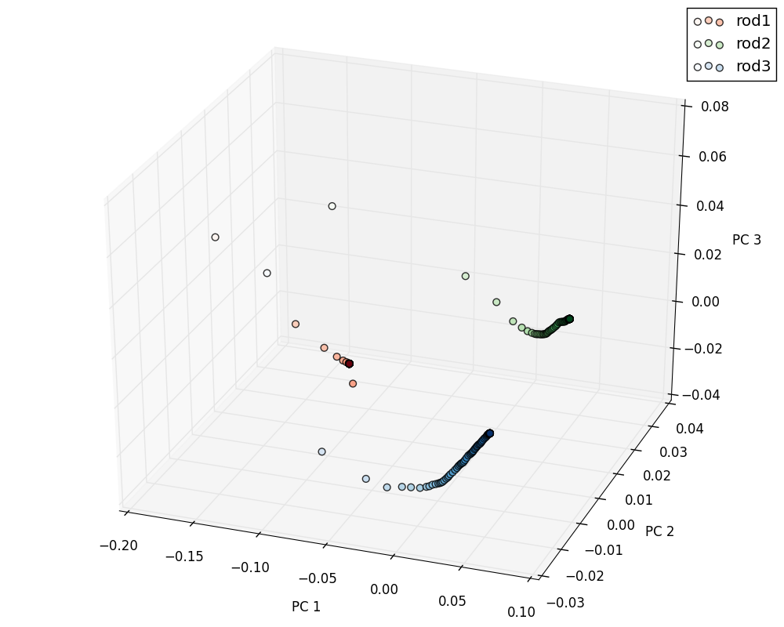
Confirming Output Effects
Verify pin shape affects chord length distribution.
Notes:
Pin shape affects chord length because there are different PCA paths

Slide 17
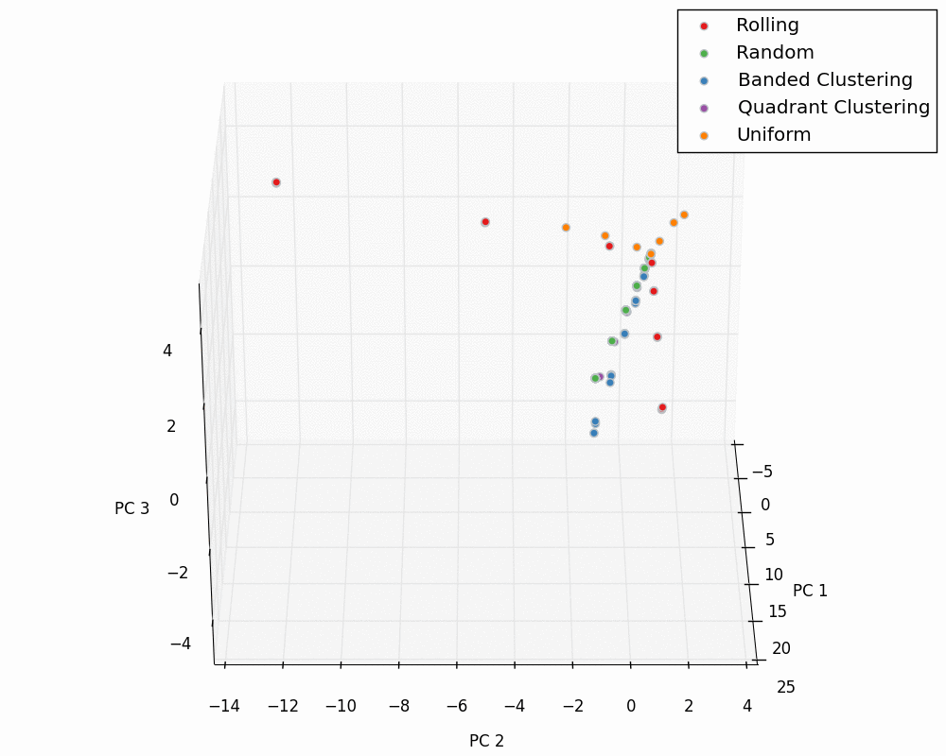
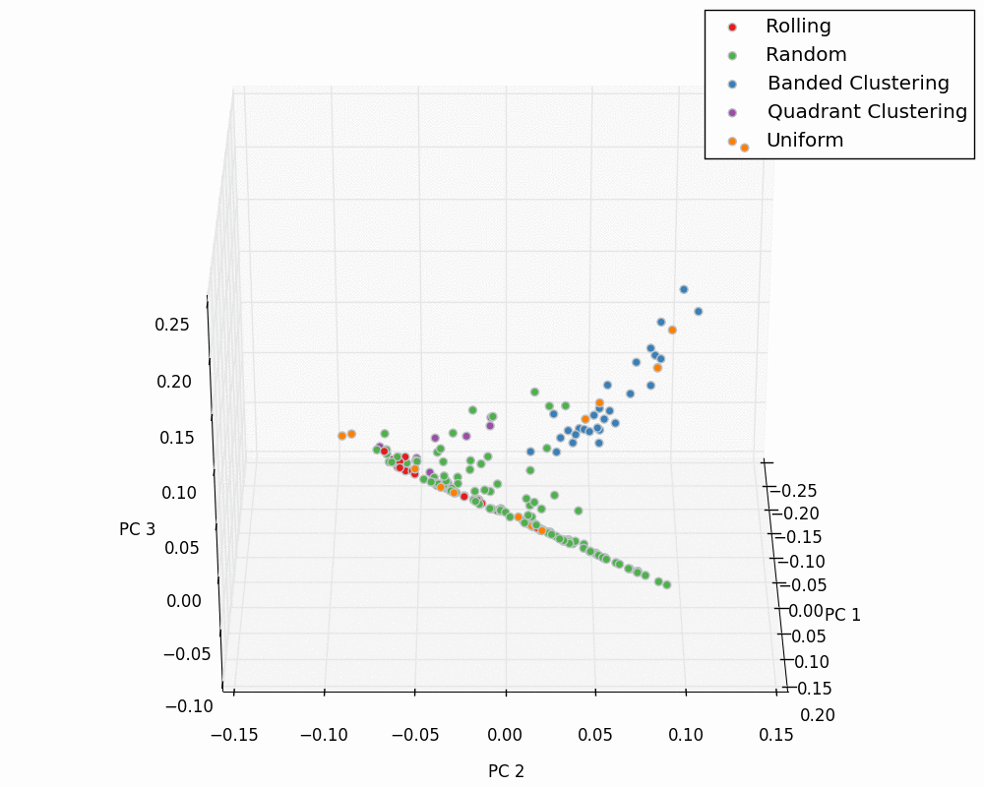
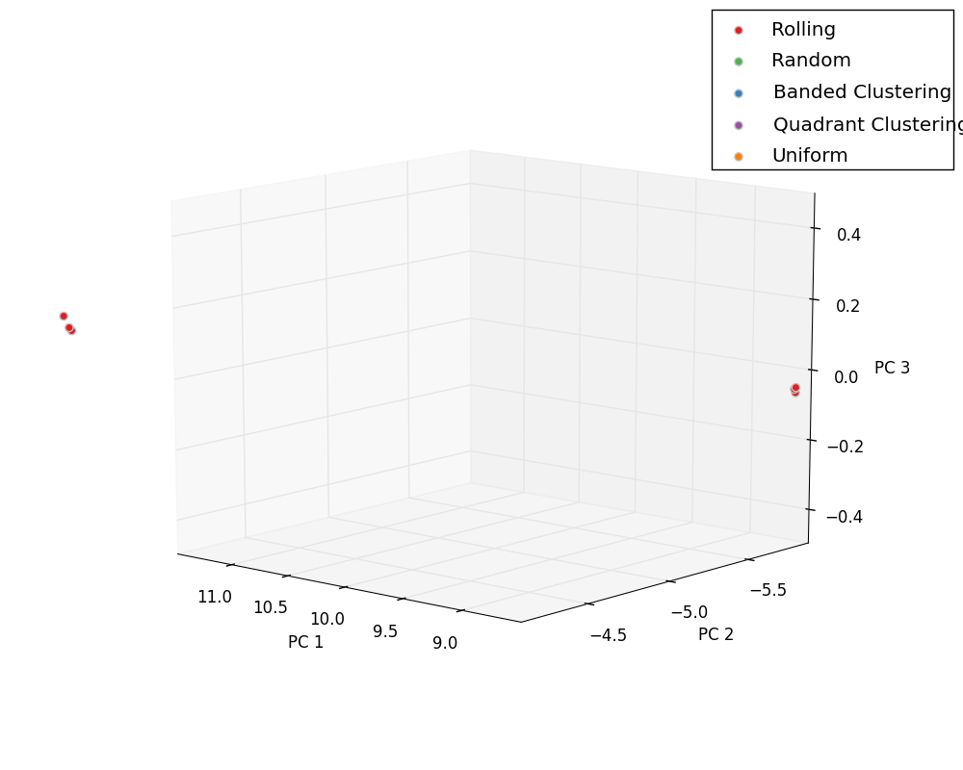
PCA: I/O
Input
Output

Slide 18
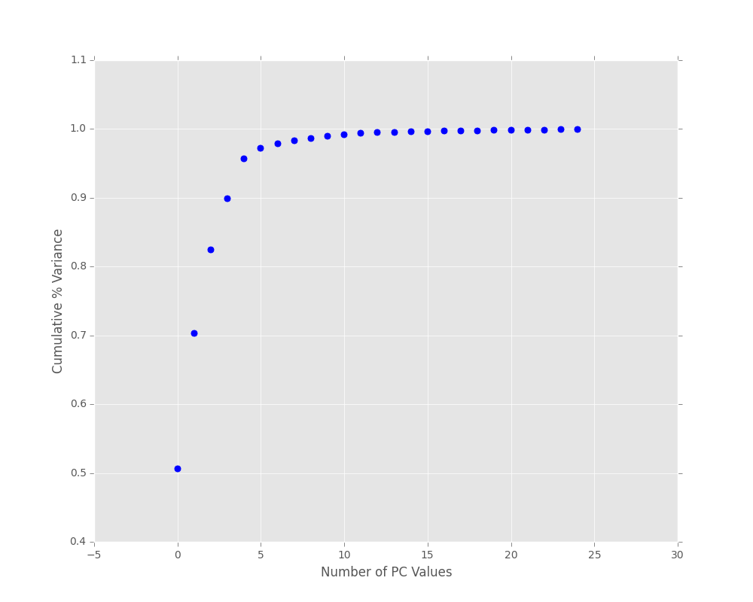
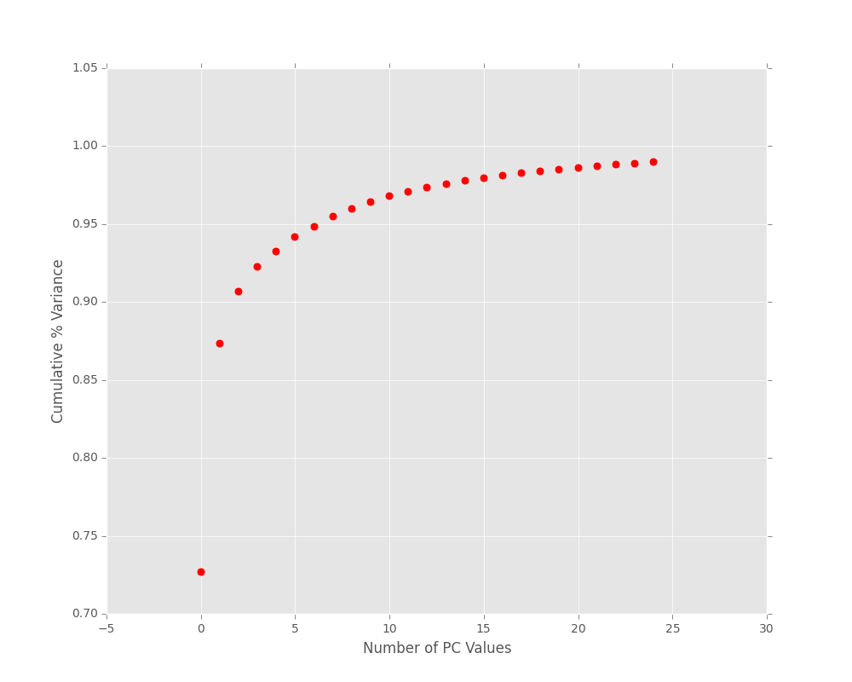
PCA: Scree Plot
Input
Output
> 95% variance in first 5 PC components.
> 95% variance in first 8 PC components.

Slide 19
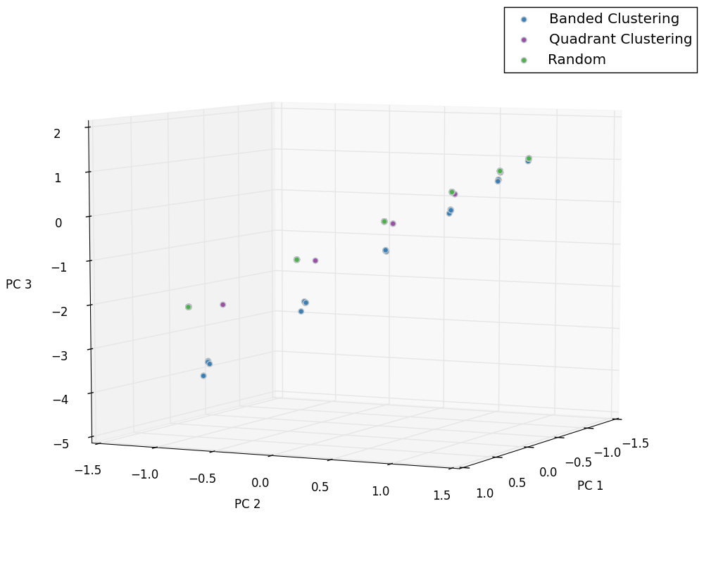
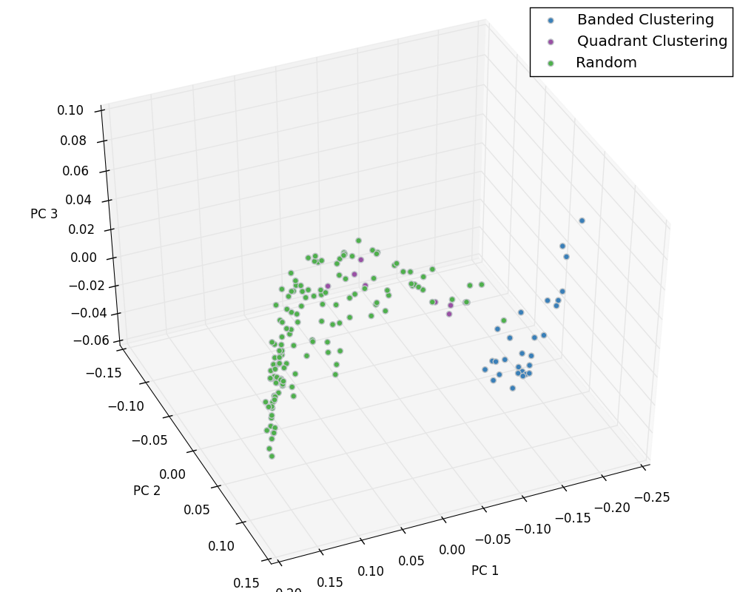
PCA: Trend Analysis I
Input
Output

Slide 20
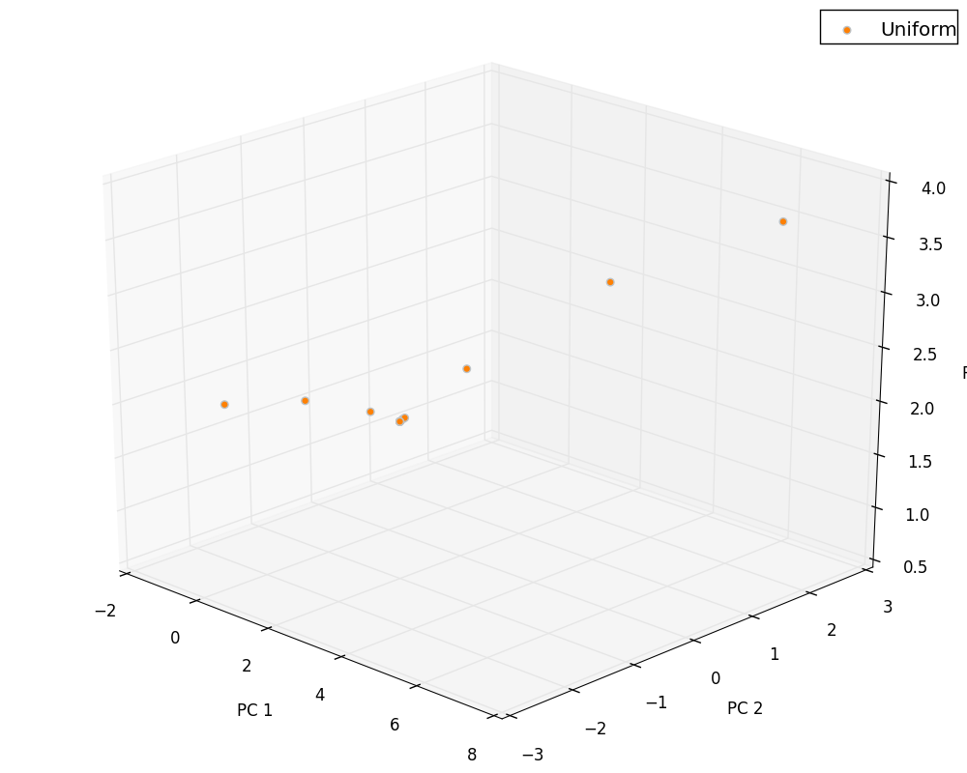
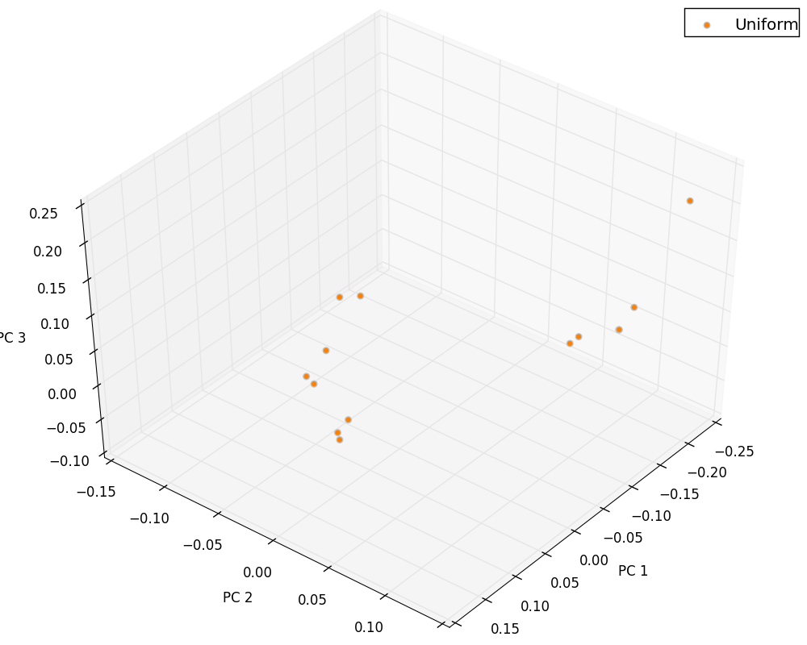
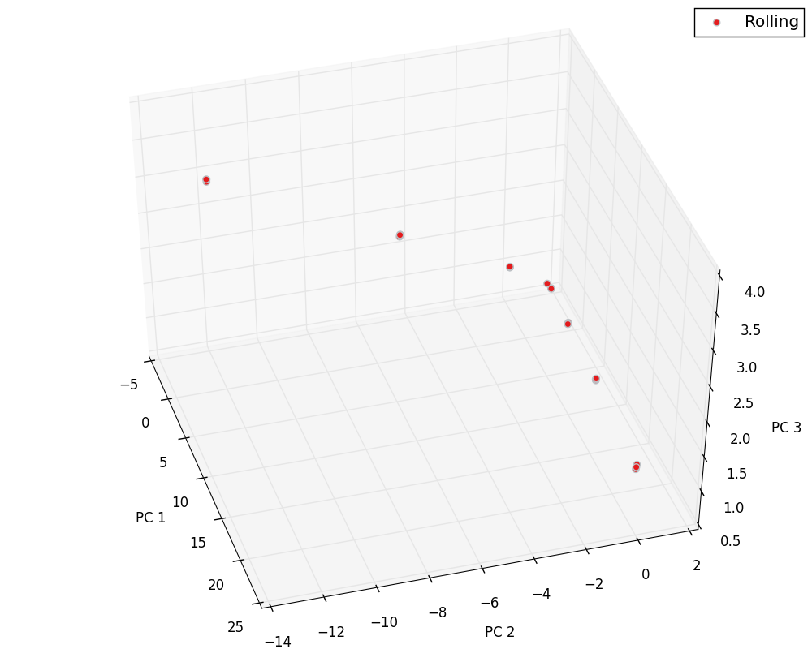
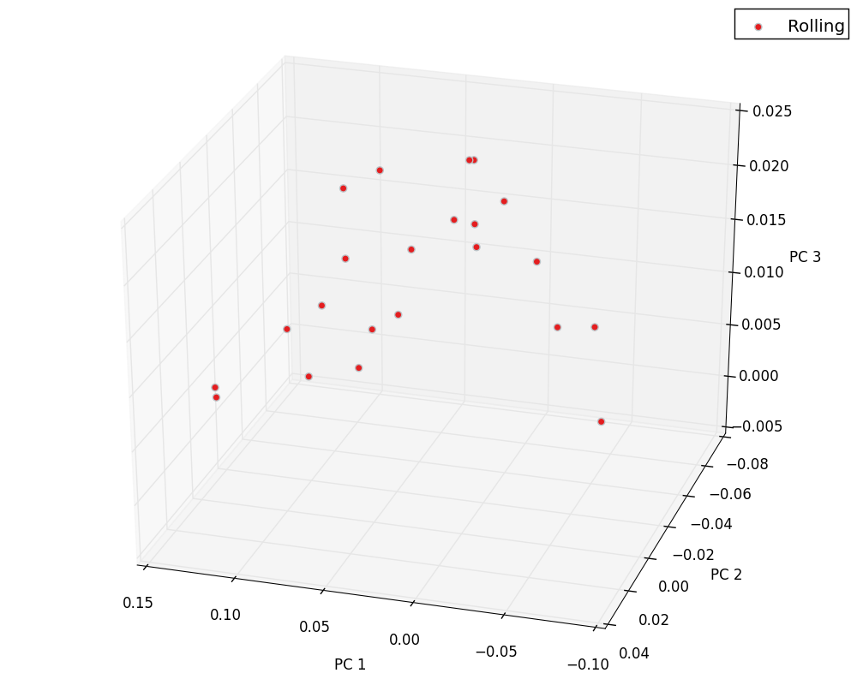
PCA: Trend Analysis II
Input
Output

Slide 21
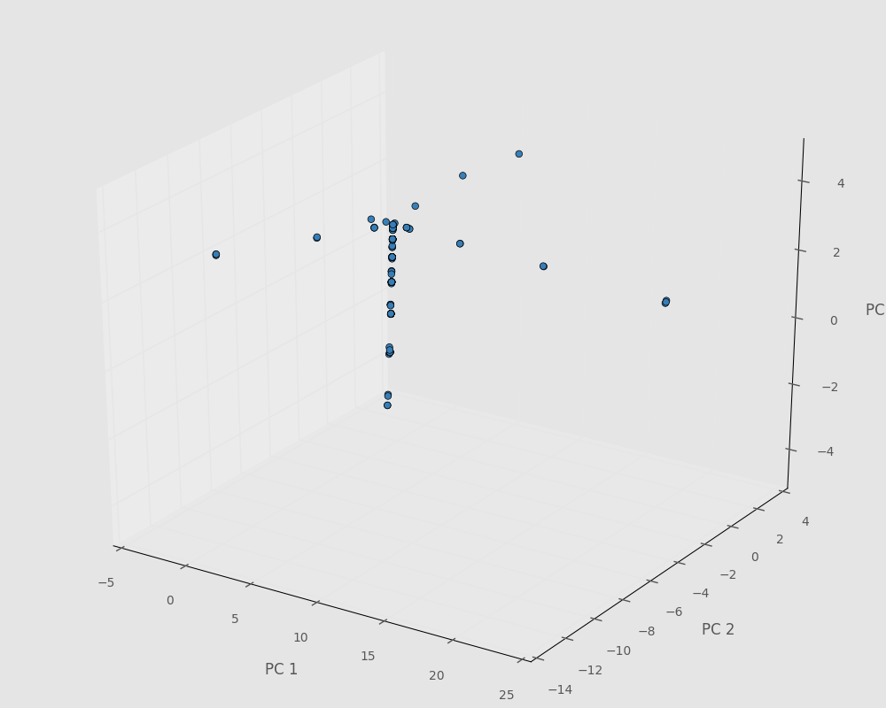
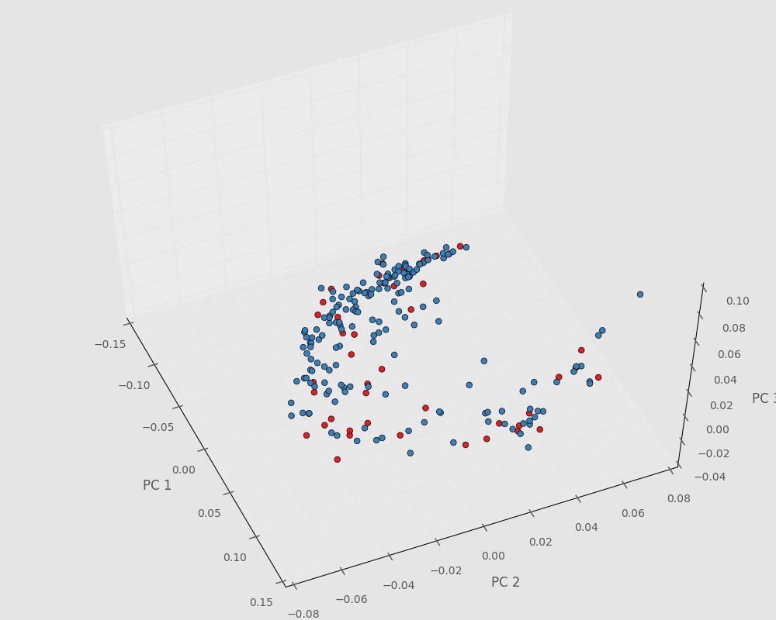
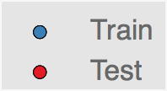
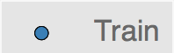
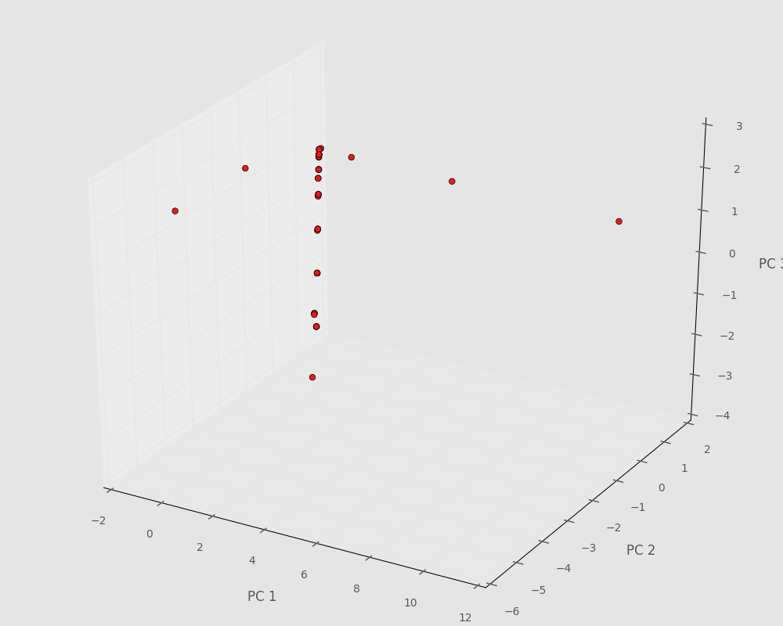
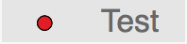
Regression
Scikit-learn based linear regression
Use 20% of our data to test

Slide 22
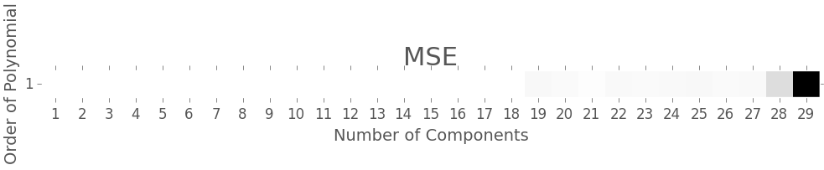
Regression Results
Construct model for every combination of
Polynomial degree: [1-5] (multivariate)
Number of PC values: [1-30] (multiple)
Leave-one-out cross-validation to optimize MSE
Best Model
Linear Regression (Order 1 polynomial) Number of Components: 10 MSE Value: 2.70392576062e-05
Notes:
Polynomial degree up to 10

Slide 23
Conclusions
Using novel data science tools a surrogate model is developed for grain boundary pinning problem during grain growth simulations.
The work done establishes a generalized, automated, and scalable framework that can be extended to other models.

Slide 24
Future Work
Evaluate current classes relevance.
Expand simulation pool to include more representative data.
Expand model capabilities and predictions for newly generated data.
Further model validation.

Slide 25
Acknowledgements
Dr. Surya Kalidindi (GT)
David Brough (GT, CSE)
Ahmet Cecen (GT, CSE)
Dr. John Mitchell (Sandia National Labs)
http://materials-informatics-class-fall2015.github.io/MIC-grain-growth/

Slide 26
References
Gladman, T. (1966). On the theory of the Effect of Precipitate Particles on Grain Growth in Metals. Proceedings of the Royal Society of London.Series A, Mathematical and Physical Sciences (294), 298-309.
Hillert, M. (1965). On the theory of normal and abnormal grain growth. Acta Metallurgica , 13, 227-238.
Kalidindi, S. (2015). Hierarchical Materials Informatics. Oxford: Elsevier.
Plimpton, S., Battaile, C., Chandross, M., Holm, L., Zhou, X., & al., e. (2009). Crossing the Mesoscale No-Man's Land via Parallel Kinetic Monte Carlo. Sandia report.
SANDIA National Lab. (2009). SPPARKS Kinetic Monte Carlo Simulator. http://spparks.sandia.gov/index.html
Wheeler, Daniel; Brough, David; Fast, Tony; Kalidindi, Surya; Reid, Andrew (2014): PyMKS: Materials Knowledge System in Python. figshare. http://dx.doi.org/10.6084/m9.figshare.1015761
http://materials-informatics-class-fall2015.github.io/MIC-grain-growth/

Slide 27
Thank you for your attention! Questions?

Slide 28
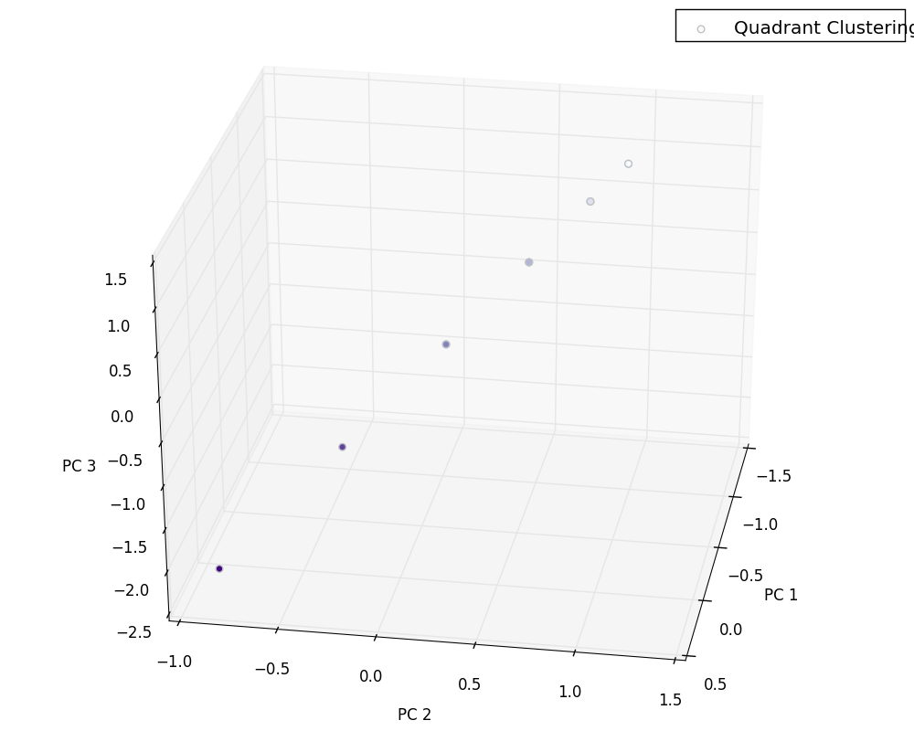
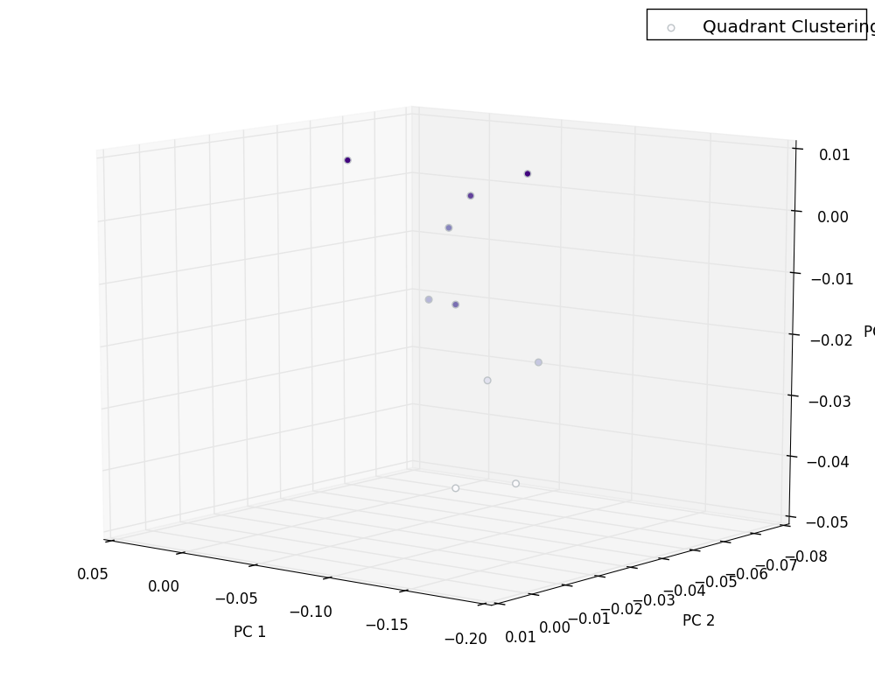
PCA: Trend Analysis III
Input
Output
Varying percentage within one class show directionality.

